Slide 1
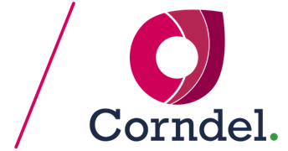
Conducting your Orchestration (afternoon session)
Level 5 Data Engineer
Higher Apprenticeship
Workshop 10

Slide 2
This check-in will take 30 45 minutes, and will be followed by resuming your hands-on exercises.

Slide 3
Check-in
How are you feeling after the morning session?
What went well?
What didn’t go so well?
What do you want to focus on this afternoon?

Slide 4
Workshop Objectives (Re-cap)
Remember the big pic:
Explain the importance of orchestration in data engineering.
Appraise the role of MLOps in orchestrating modern data workflows.
Implement infrastructure as code using AWS CloudFormation.
Orchestrate ML workflows using Argo Workflows on Amazon EKS.
Using the KSBs gained from this workshop, demonstrate how HR can utilise risk classifications to develop targeted retention strategies in a real-world scenario.
Containerise machine learning models with Docker and manage them via Amazon ECR.

Slide 5
Architectural Points

Slide 6
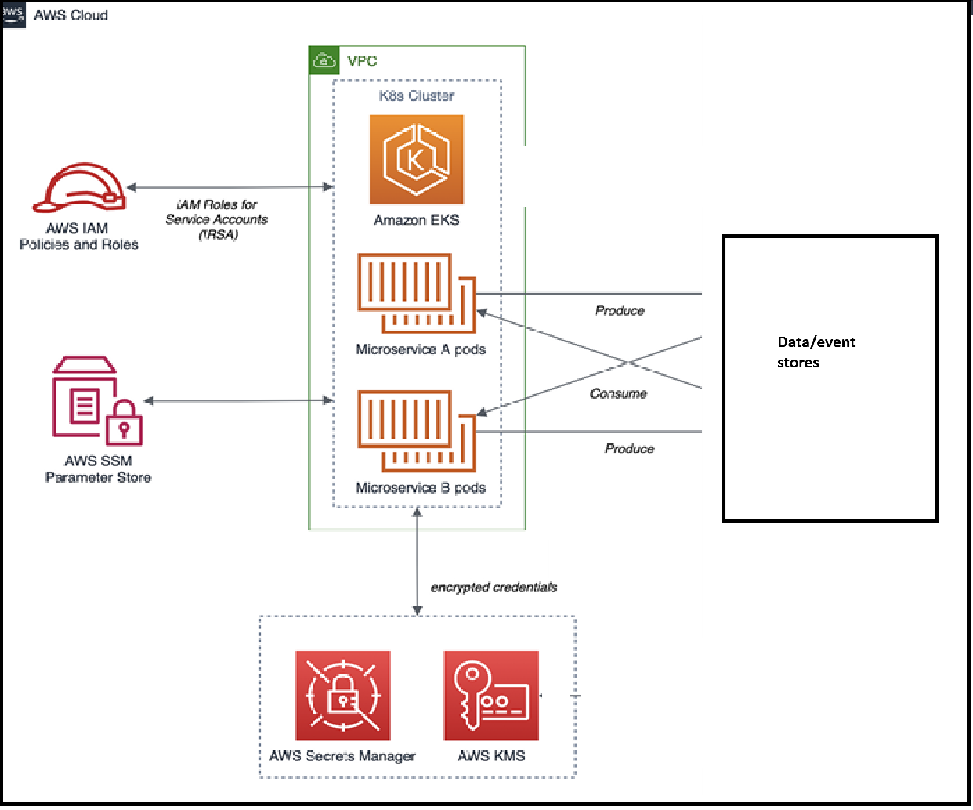

Slide 7
Flexibility: Scale only the parts that need more compute (e.g., model training) without impacting other services.
Decoupling: Each service can be updated, tested, and redeployed on its own.
Resilience: If the ML service is having issues, it doesn’t take down ingestion or notifications.

Slide 8
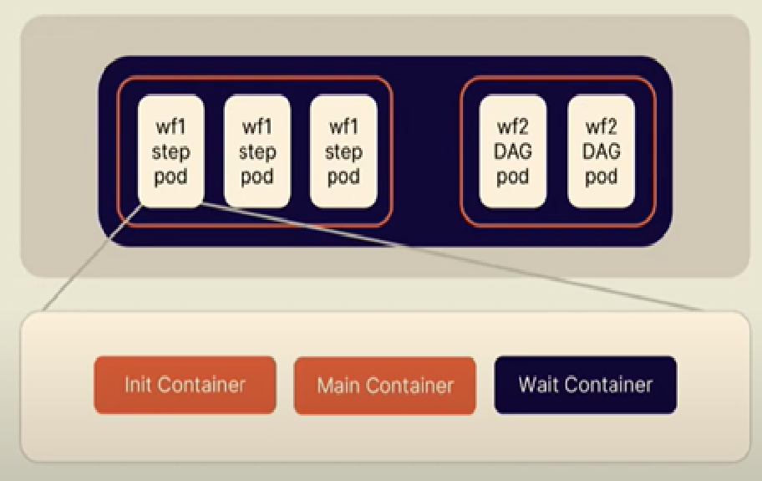
Anatomy of a pod containing a workflow

Slide 9
Remember!
Argo or Airflow is not “one more microservice,” but an orchestration layer that triggers or sequences these services.
A “microservice” is essentially a fancy word for containers that run the code for an important “service” in isolation (examples: API service, ingestion service, ML service, notification service, etc.)

Slide 10
Consensus and Scaling

Slide 11
Kubernetes vs Argo: responsibilities
K8s uses horizontal pod autoscalers, meaning it spins up more replicas of a microservice if utilisation is high.
K8s uses load balancing to distribute requests among pods.
K8s uses a consensus mechanism ensuring consistency across nodes
Argo scales by using workflow parallelism, i.e. can run steps simultaneously if they’re not mutually dependent (or belong to different workflows entirely).
Argo handles dependencies well (like “train after data ingest finishes”) inside a workflow.
K8s keeps the cluster running, Argo keeps the workflows organised.

Slide 12
Consolidation of previous material. Questions about AWS Glue vs. Orchestration.
If we only had Glue, how would we manage frequent model retraining, multiple microservices, or real-time inference? What overhead might we face?
In which cases might Glue still be enough for part of the pipeline—and where does an orchestrator like Argo clearly shine?
Which one is better for rapid iteration and why?

Slide 13
Top tip: Remember to make thorough notes from your discussions in a learning journal, or another resource you can refer to later.

Slide 14

Your PDE will guide you through the remaining activities.

